Slide 1
SUTURING

Slide 2
INTRODUCTION
Surgical suture is a medical device used to hold body tissues together after an injury or surgery.
A number of different shapes, sizes of needles and thread materials are used.
The choice of sutures and needles is determined by the location of the lesion, the thickness of the skin in that location, and the amount of tension exerted on the wound.
Surgical knots are used to secure the sutures

Slide 3
IDENTIFICATION
Suture threads: 1. Absorbable: catgut, synthetic.
2. Non absorbable: natural- silk linen, synthetic- nylon, Dacron, proline.
Needles: straight and curved. Different sized needles are used for different types of wounds
Surgical towel, towel clips, forceps( artery forceps, toothed forceps, sponge holding forceps), needle holder, linen, nylon

Slide 4
Types of surgical needle
Straight
1/4 circle
3/8 circle
1/2 circle. Subtypes of this needle shape include, from larger to smaller size, CT, CT-1, CT-2 and CT-3.
5/8 circle
compound curve
half curved (also known as ski)
half curved at both ends of a straight segment (also known as canoe)

Slide 5
Taper (needle body is round and tapers smoothly to a point)
Cutting (needle body is triangular and has a sharpened cutting edge on the inside curve)
Reverse cutting (cutting edge on the outside)
Trocar point or tapercut (needle body is round and tapered, but ends in a small triangular cutting point)
Blunt points for sewing friable tissues
Side cutting or spatula points (flat on top and bottom with a cutting edge along the front to one side) for eye surgery

Slide 6
Surgical needles

Slide 7
SURGICAL INSTRUMENTS

Slide 8
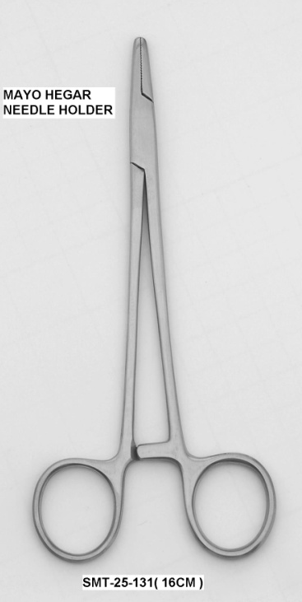
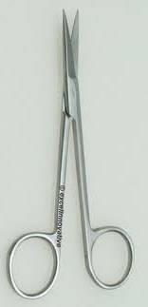
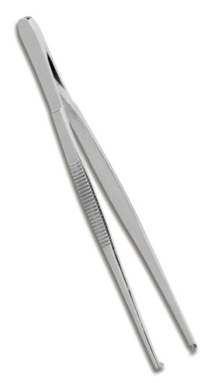
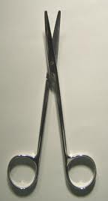
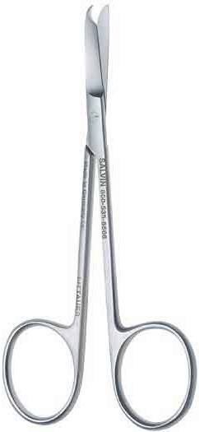
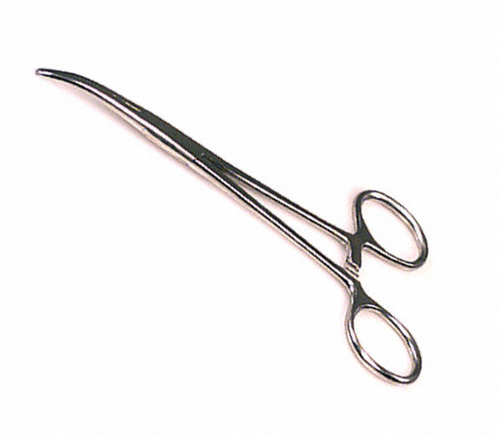
Notes:
Tissue forceps, needle holder, iris scissors, dissection scissors, hemostats, suture removal scissors

Slide 9
PROCEDURE
Suture placement:
A needle holder is used to grasp the needle at the distal portion of the body, one half to three quarters of the distance from the tip of the needle, depending on the surgeon’s preference.
The needle holder is tightened by squeezing it until the first ratchet catches.
The needle holder should not be tightened excessively, because damage to both the needle and the needle holder may result.
The needle is held vertically and longitudinally perpendicular to the needle holder.

Slide 10
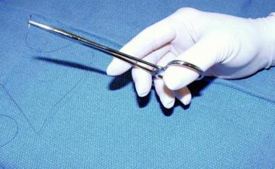
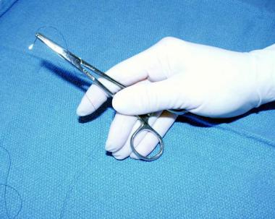

Slide 11
Needle is placed vertically and longitudinally perpendicular to needle holder.
The tissue must be stabilized to allow suture placement.
Depending on the surgeon’s preference, toothed or untoothed forceps or skin hooks may be used to grasp the tissue gently.
Forceps are necessary for grasping the needle as it exits the tissue after a pass. Before removal of the needle holder, grasping and stabilizing the needle is important.

Slide 12
The needle should always penetrate the skin at a 90° angle, which minimizes the size of the entry wound and promotes eversion of the skin edges. The needle should be inserted 1-3 mm from the wound edge, depending on skin thickness.
Knot tying:
First, the tip of the needle holder is rotated clockwise around the long end of the suture for two complete turns (see the image below). The tip of the needle holder is used to grasp the short end of the suture.

Slide 13
The short end of the suture is pulled through the loops of the long end by crossing the hands, so that the two ends of the suture are on opposite sides of the suture line.
The needle holder is rotated counterclockwise once around the long end of the suture.
The short end is then grasped with the needle holder tip and pulled through the loop again.

Slide 14
Knot tying

Slide 15
USES
For closing dead space
Supporting and strengthening wounds until healing increases their tensile strength
Approximating skin edges for an aesthetically pleasing and functional result
Minimizing the risks of bleeding and infection

